Slide 1
5.3 Least Absolute Deviations

Slide 2
In this Section we talk about a slight twist on the derivation of the Least Squares cost function that leads to an alternative cost for linear regression called Least Absolute Deviations.
This alternative cost function is much more robust to outliers in a dataset than the original Least Squares.

Slide 3
The susceptibility of the Least Squares cost to outliers

Slide 4
One downside of using the squared error in the Least Squares cost is that squaring the error increases the importance of larger errors.
In particular squaring errors of length greater than 1 makes these values considerably larger.
This forces weights learned via the Least Squares cost to produce a linear fit that is especially focused on trying to minimize these large errors.
This is often due to outliers in a dataset.

Slide 5
In other words, the Least Squares cost produces linear models that tend to overfit to outliers in a dataset.
We illustrate this fact via a simple dataset in the following example.

Slide 6
Example: Least Squares overfits to outliers

Slide 7
In this example we use the dataset plotted below.
This dataset can largely be represented by a proper linear model with the exception of a single large outlier.
This example shows how the Least Squares cost function for linear regression tends to create linear models that overfit to outliers.

Slide 8
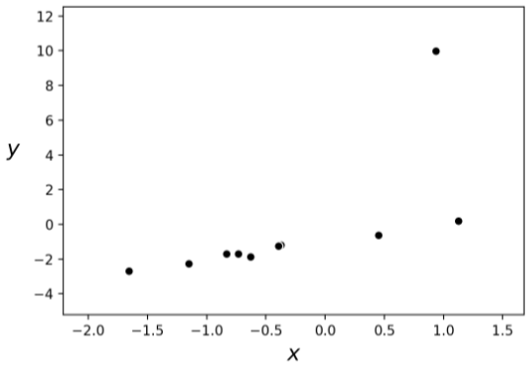

Slide 9
We now tune the parameters of a linear regressor to this dataset by minimizing the Least squares cost via gradient descent.
We plot the linear model associated with those weights providing the smallest cost function values.
This fit (shown in black) does not fit the majority of the data points well, bending upward clearly to with the aim of minimizing the large squared error on the singleton outlier point.

Slide 10
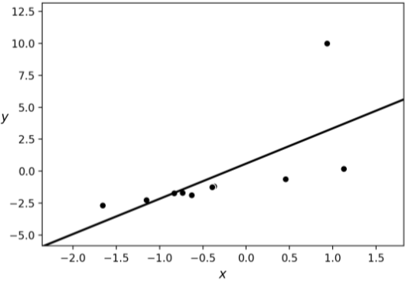

Slide 11
Replacing squared error with absolute error

Slide 12
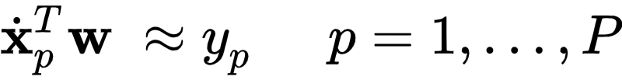
How can we make our linear regression framework more robust to outliers?
Remember our aim in learning a linear regressor is to learn a set of ideal weights so that
To learn these ideal weights the first step we took there was to square the difference between as

Slide 13
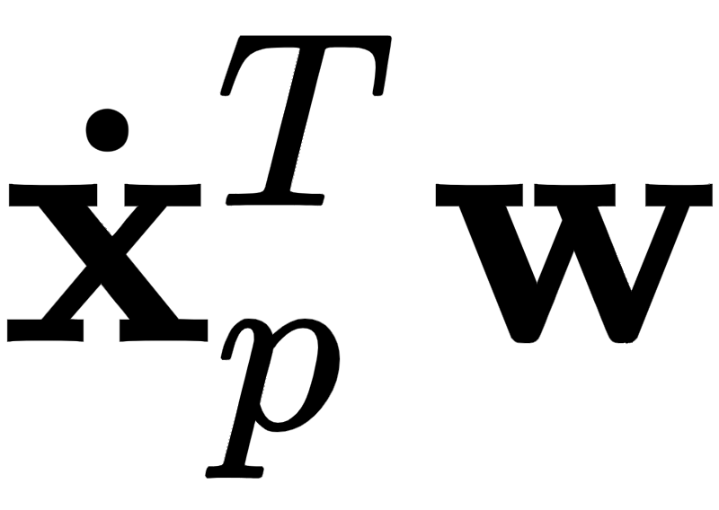
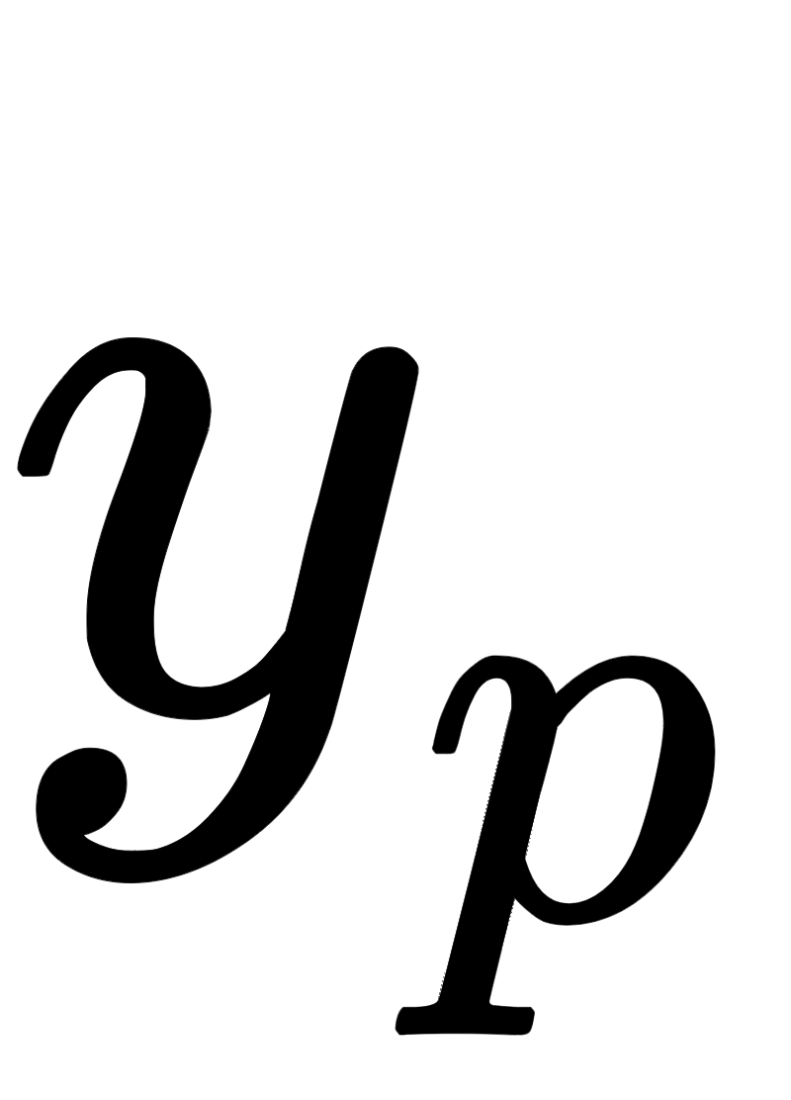
Each of these measures the squared error between model and
Taking the average of these P squared error terms gave us the Least Squares cost function.

Slide 14
As an alternative to using a squared error for our point-wise cost we can instead measure the absolute error as
By using absolute error instead of the squared variety we still treat negative and positive errors equally.
But we do not exaggerate the importance of large errors greater than $1$ (since, of course, we do not square them).

Slide 15
If we form the average of these absolute error point-wise costs we have the so-called Least Absolute Deviations cost function

Slide 16
This cost function is also always convex regardless of the input dataset (like Least Squares).
But you can't use Newton's method to minimize this in a single step - it doesn't have a useful second derivative (its zero almost everywhere).
Even though it is not differentiable everywhere, you can use gradient descent to minimize it.
Technically speaking when doing this, you're using "subgradient descent", but it works all the same.

Slide 17
Example: Least absolute deviations versus Least Squares

Slide 18
In implementing the cost in `Python` we can employ the ``model`` function we used with our Least Squares implementation shown in the previous Section.
All we then need to do is slightly alter the cost function itself to get our desired implementation, as shown below.

Slide 19
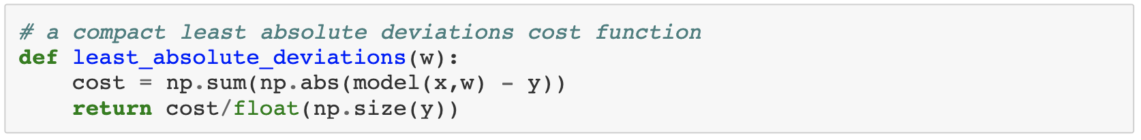

Slide 20
Below we plot the surface / contour plot of this cost function using the previously shown dataset - indeed it is convex.

Slide 21
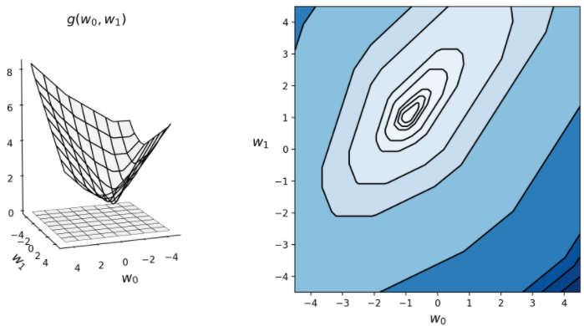

Slide 22
We plot and compare the best fit found via gradient descent for both Least Squares and Least Absolute Deviations cost functions on the dataset.
The Least Squares fit is shown in black, while the Least Absolute Deviation fit is shown in magenta.
The latter fits considerably better, since it does not exaggerate the large error produced by the single outlier.

Slide 23
